Slide 1
Convert Rocket.Chat Endpoints to New
Pattern
Google Summer of Code Project Demo
Notes:
Hello everyone, my name is Ahmed Nasser. Today I will share the work we did on updating Rocket.Chat’s API endpoints to a new standard using OpenAPI and Ajv
Transition: Let’s start with a quick overview of the project

Slide 2



Project Overview
Goal: Migrate Rocket.Chat API endpoints to a new OpenAPI + Ajv JSON schema validator
Focus: OpenAPI specs, Ajv validation, Typia-generated schemas
Impact: Easier to maintain, more trusted by developers, always updated documentation
Notes:
The goal of this project was simple: move Rocket.Chat’s old API endpoints into a modern system. We used OpenAPI for clear documentation, Ajv for validating requests, and Typia for generating schemas. This makes the system easier to maintain, trusted by developers, and keeps documentation always updated
Transition: Next slide: the team who worked on this.

Slide 3


Team
Ahmed Nasser
Contributor
Matheus Cardoso
Guilherme Gazzo
Mentor
Co-mentor
Notes:
Here’s the amazing team behind this project. I worked under the guidance of Matheus Cardoso as my mentor, and Guilherme Gazzo as my co-mentor. Together, we collaborated closely to bring OpenAPI integration to Rocket.Chat. I was the contributor responsible for implementing the changes
Transition: Now that you’ve met the team, let’s talk about the foundation of this project — OpenAPI and why it’s important

Slide 4

What is OpenAPI and Why Use It?
standard way to describe REST APIs.
Single source of truth for endpoints.
Auto-generated docs & SDKs.
Type safety for requests & responses.
Helps AI agents call APIs correctly
Faster onboarding & fewer bugs
Notes:
OpenAPI is a standard way to describe REST APIs. It gives us a single source of truth for each endpoint, so docs, types, and code stay in sync. It also allows auto-generated documentation, SDKs, and ensures requests and responses are strongly typed. Even AI tools can benefit by calling APIs correctly. Overall, it helps teams onboard faster and reduce bugs.
Transition: Now, let’s see why migrating Rocket.Chat to OpenAPI with AJV is so important

Slide 5
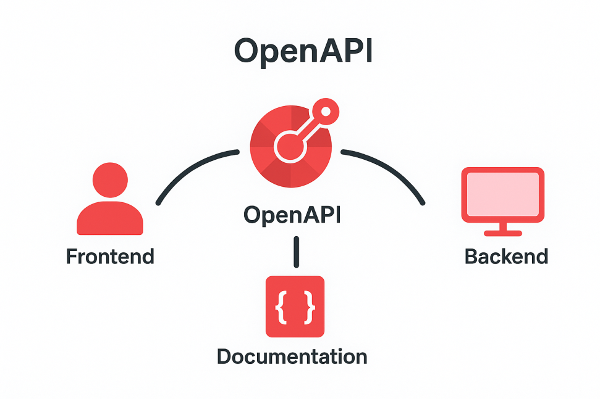
Why Migrate to OpenAPI + AJV?
Replaces outdated manual YAML files
Automatic schema validation for requests & responses
TypeScript types sync with the backend
Cost & time savings for the team
Notes:
Previously, Rocket.Chat relied on manual YAML files, which were hard to maintain and often outdated. By migrating to OpenAPI + AJV, we get automatic validation for requests and responses, TypeScript types that stay in sync with the backend, and overall cost and time savings for the team
Transition: Next, I’ll show you what’s new in our API pattern

Slide 6
What’s New in Our API Pattern?
.post() / .get() chaining with inline schemas
Validation and docs in route definitions
Typia $ref schema reuse
Auto TypeScript typings
Predefined error responses
Notes:
The new API pattern simplifies how we define endpoints. Now, routes use .post() and .get() chaining with inline schemas. Validation and documentation are inside the route definitions. With Typia, we can reuse schemas via $ref. The best part is automatic TypeScript typings and predefined error responses built in
Transition: But to really see the difference, let’s compare the old pattern with the new one

Slide 7
Old Pattern vs New Pattern (side-by-side)
Old Pattern
New Pattern
Traditional endpoint definition with separate validation logic
OpenAPI + AJV with inline schemas and integrated validation
Manual validation
Type mismatch risk
AJV validation
Docs in sync
Auto TypeScript
Separate docs
Schema reuse
Notes:
Here’s a side-by-side comparison. In the old pattern, we had manual validation, separate docs, and a risk of type mismatches. The new pattern integrates AJV validation, keeps docs always in sync, auto-generates TypeScript, and reuses schemas efficiently
Transition: A big benefit of this new system is strong type safety. Let’s look at that next

Slide 8
Type Safety
Old Pattern
New Pattern
Traditional endpoint definition with separate validation logic
OpenAPI + AJV with inline schemas and integrated validation
Manual validation
Type mismatch risk
AJV validation
Docs in sync
Auto TypeScript
Separate docs
Schema reuse
Notes:
Before, we had to manually maintain typings in rest-typings, which was error-prone. Now, types are generated automatically. On the frontend, when developers use useEndpoint, TypeScript shows exactly what the API returns. This makes development faster and safer
Transition: With types in place, we can also unlock new opportunities like SDK generation

Slide 9
SDK Generation Potential
From API definitions generate SDKs automatically
Consistent APIs across languages (JS, Python, etc.)
Less manual code to maintain
Notes:
Another benefit is SDK generation. From our API definitions, we can auto-generate SDKs in different languages like JavaScript and Python. This ensures consistency and reduces the amount of manual code we need to maintain
Transition: Speaking of consistency, this also helps AI use our APIs safely

Slide 10
AI Use Cases
APIs exposed in structured format
Prevents AI from “hallucinating” fake endpoints
AI agents can call APIs ‘safely’ via MCP
Bridges AI + Rocket.Chat
Notes:
By exposing APIs in a structured format, we help AI agents call them safely. This prevents the problem of hallucinating fake endpoints. With MCP integration, AI can directly interact with Rocket.Chat through our APIs — bridging AI and our platform.
Transition: And now, let me show you all of this in action with a short recorded demo

Slide 11

Demo (Recorded Video)
Notes:
In this demo, I’ll show how the frontend now sees correct return types using useEndpoint. I’ll also walk through Swagger UI with migrated endpoints, an example request validated by AJV, and how documentation and response examples are automatically generated from the same schemas
Play the video. (Click Play on the embedded video.)
Transition:
That was the demo — let’s summarize what we’ve achieved and why it matters

Slide 12
Summary
Migrated APIs to OpenAPI + Ajv
Stronger type safety & validation
Auto-generated docs & typings
Faster onboarding, fewer bugs
Future-ready: SDKs & AI integration
Notes:
We started with the challenge of outdated manual API definitions.
We introduced OpenAPI and Ajv validation as a single source of truth.
The new pattern improves type safety, validation, and documentation — all in one place.
It saves the team time, reduces bugs, and makes onboarding easier.
It also unlocks future opportunities: SDK generation, AI use cases, and stronger developer trust.
Closing & Call to Action: In short: this migration isn’t just a technical upgrade — it’s an investment in reliability, productivity, and the future of Rocket.Chat APIs. Thank you

